Slide 1
SESSION 7,8&9
TRADITIONAL SYMMETRIC KEY CRYPTOGRAPHY & CRYPTANALYSIS

Slide 2
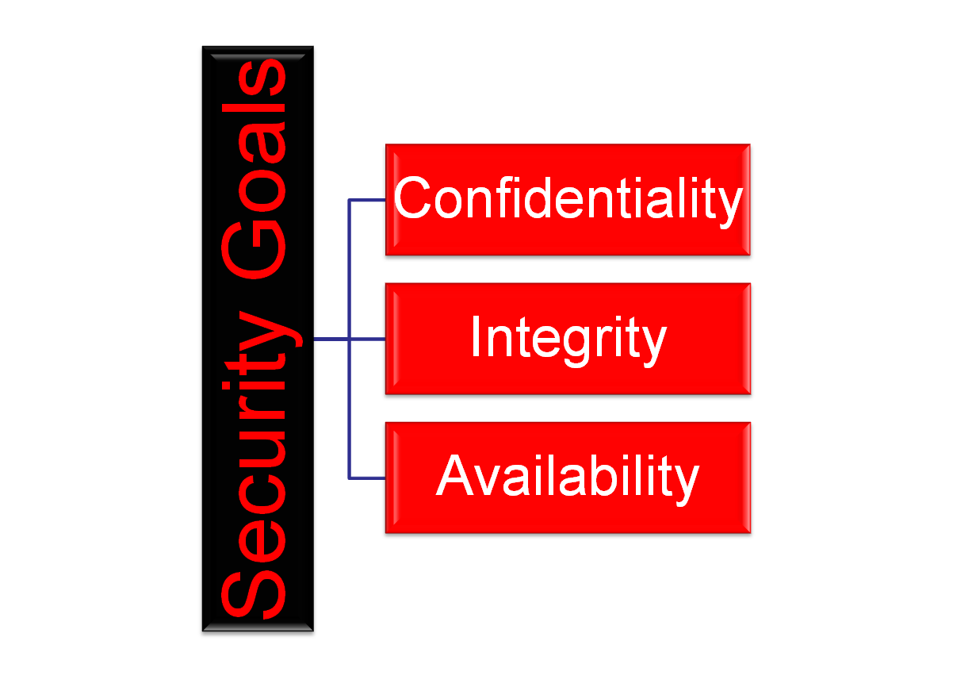
Taxonomy of Security Goals
Notes:
1.#

Slide 3
Confidentiality & Integrity
Confidentiality: is probably the most common aspect of information security. We need to protect our confidential information. An organization needs to guard against those malicious actions that endanger the confidentiality of its information.
Integrity: Information needs to be changed constantly. Integrity means that changes need to be done only by authorized entities and through authorized mechanisms.
Notes:
1.#

Slide 4
Availability: Means to Achieve CIA
Availability: This is the third component of information security. The information created and stored by an organization needs to be available to authorized entities.
Information needs to be constantly changed, which means it must be accessible to authorized entities.
MEANS TO ACHIEVE CIA:
Cryptography
Symmetric Key Cryptography
Asymmetric Key Cryptography
Notes:
1.#

Slide 5
Basic terminology
Plaintext: original message to be encrypted
Ciphertext: the encrypted message
Enciphering or encryption: the process of converting plaintext into ciphertext
Encryption algorithm: performs encryption
  Two inputs: a plaintext and a secret key

Slide 6
Deciphering or decryption: recovering plaintext from ciphertext
Decryption algorithm: performs decryption
  Two inputs: ciphertext and secret key
Secret key: same key used for encryption and decryption
  Also referred to as a symmetric key

Slide 7
Cipher or cryptographic system : a scheme for encryption and decryption
Cryptography: science of studying ciphers
Cryptanalysis: science of studying attacks against cryptographic systems
Cryptology: cryptography + cryptanalysis

Slide 8
Ciphers
Symmetric cipher: same key used for encryption and decryption
  Block cipher: encrypts a block of plaintext at a time (typically 64 or 128 bits)
  Stream cipher: encrypts data one bit or one byte at a time
Asymmetric cipher: different keys used for encryption and decryption

Slide 9
Symmetric Encryption
Mathematically:
  Y = E_{K}(X) or Y = E(K, X)
  X = D_{K}(Y) or X = D(K, Y)
X = plaintext
Y = ciphertext
K = secret key
E = encryption algorithm
D = decryption algorithm
Both E and D are known to public

Slide 10
Cryptanalysis
Objective: to recover the plaintext of a ciphertext or, more typically, to recover the secret key.
Kerkhoff’s principle: the adversary knows all details about a cryptosystem except the secret key.
Two general approaches:
  brute-force attack
  non-brute-force attack (cryptanalytic attack)

Slide 11
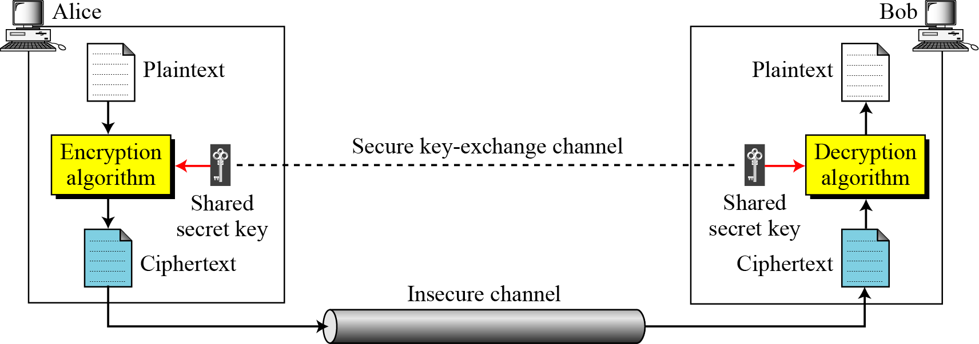
SYMMETRIC KEY CRYPTOGRAPHY: THE MODEL
Symmetric Key Cryptography: Classical Systems & Modern Systems
Transposition Cipher
Substitution Cipher
3.<number>

Slide 12

In transposition cipher the individuals plain alphabet does not change its identity but changes its relative position: It could be either Keyless or Keyed Transposition Ciphers
Keyless Transposition Ciphers
The rail fence cipher. The ciphertext is created reading the pattern row by row. For example, to send the message “Meet me at the park” to Bob, Alice writes
She then creates the ciphertext “MEMATEAKETETHPR”.

Slide 13
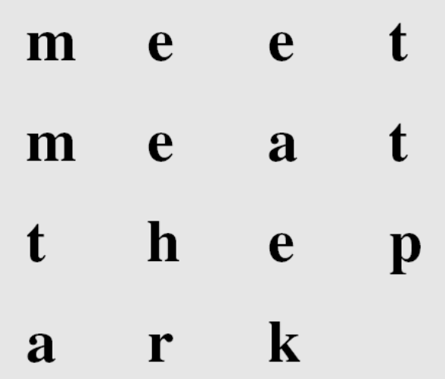
Continued
Example
Alice and Bob can agree on the number of columns and use the second method. Alice writes the same plaintext, row by row, in a table of four columns.
She then creates the ciphertext “MMTAEEHREAEKTTP”.

Slide 14
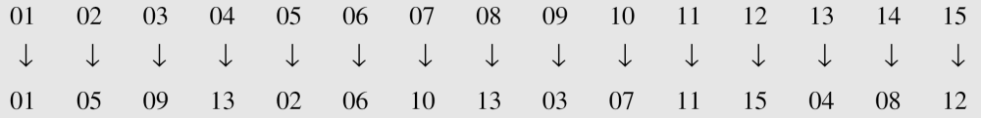
Continued
Example
The following shows the permutation of each character in the plaintext into the ciphertext based on the positions.
The second character in the plaintext has moved to the fifth position in the ciphertext; the third character has moved to the ninth position; and so on. Although the characters are permuted,
there is a pattern in the permutation: (01, 05, 09, 13), (02, 06, 10, 14), (03, 07, 11, 15), and (04, 08, 12). In each section, the difference between the two adjacent numbers is 4.
3.<number>

Slide 15

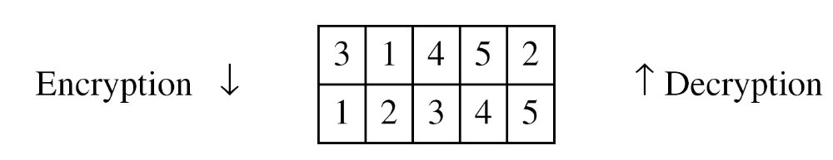
In Keyless transposition the plaintext is written in one way and reading it in another way i.e. the permutation is done on the whole plaintext to create the whole ciphertext.
Another method is to divide the plaintext into groups of predetermined size, called blocks, and then use a key to permute the characters in each block separately.
The key used for encryption and decryption is a permutation key, which shows how the character are permuted.
The permutation yields

Slide 16
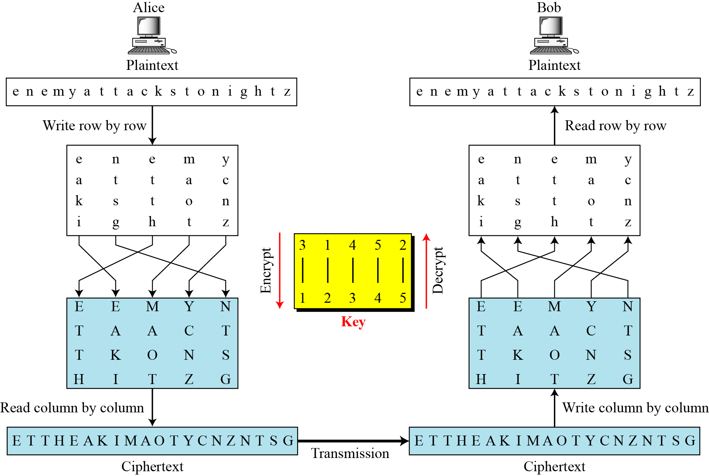
Combining Two Approaches
Example

Slide 17
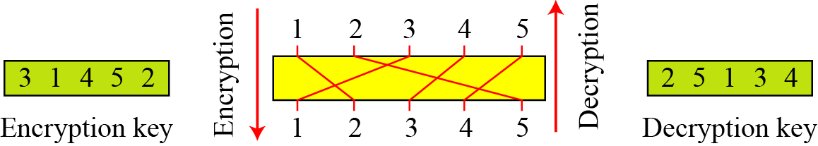
Keys
In a single key was used in two directions for the column exchange: downward for encryption, upward for decryption. It is customary to create two keys.
Encryption/decryption keys in transpositional ciphers

Slide 18
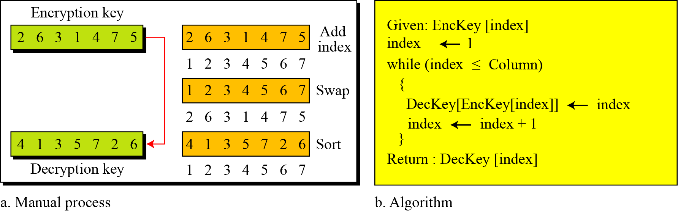
Key inversion in a transposition cipher

Slide 19
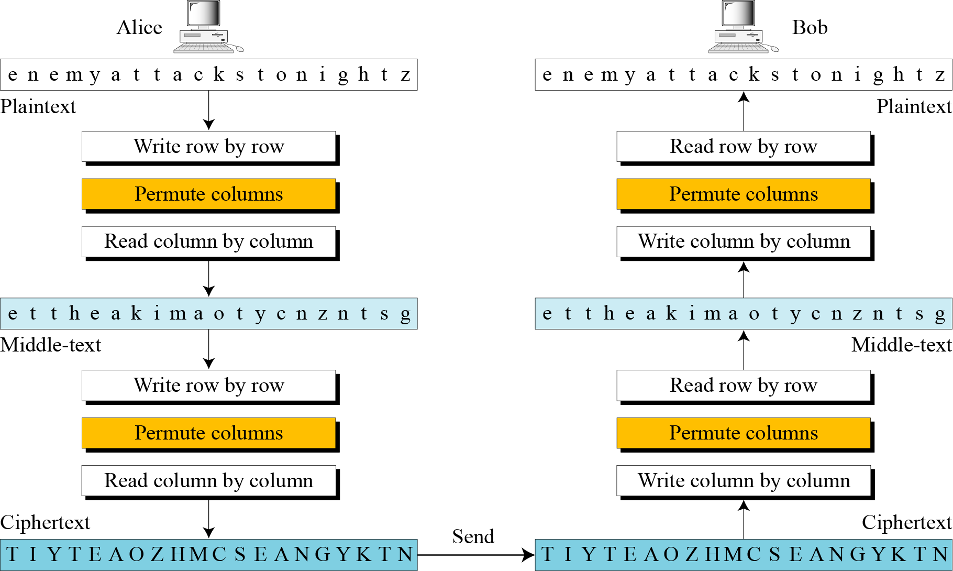
Double Transposition Ciphers
3.<number>

Slide 20
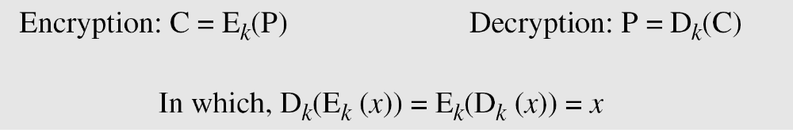
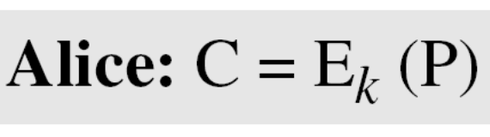
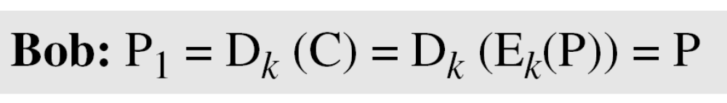
Mathematical Representation of Cryptography
If P is the plaintext, C is the ciphertext, and K is the key,
We assume that Bob creates P₁; we prove that P₁ = P:
3.<number>

Slide 21
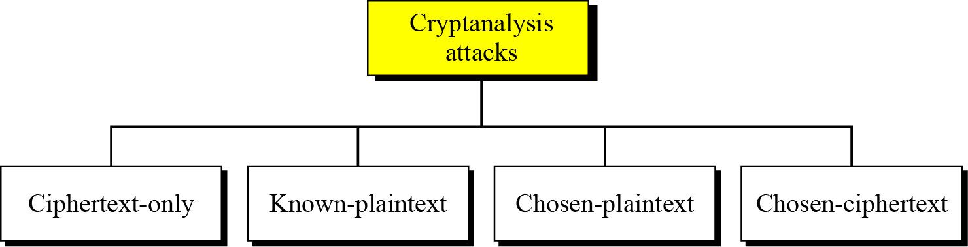
Cryptanalysis: Classical Systems
Kerckhoff’s principle: , one should always assume that the adversary, knows the encryption/decryption algorithm. The resistance of the cipher to attack must be based only on the secrecy of the key.
As cryptography is the science and art of creating secret codes, cryptanalysis is the science and art of breaking those codes.

Slide 22
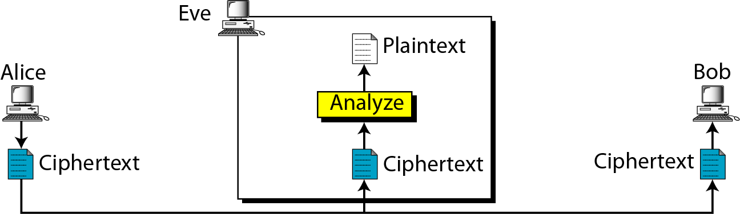
Ciphertext-Only Attack

Slide 23
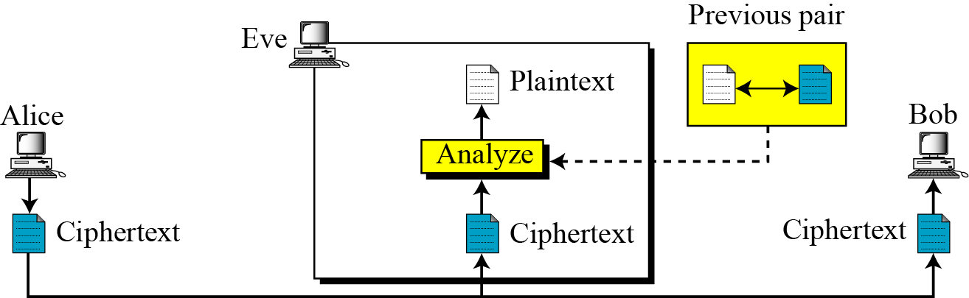
Known-Plaintext Attack

Slide 24
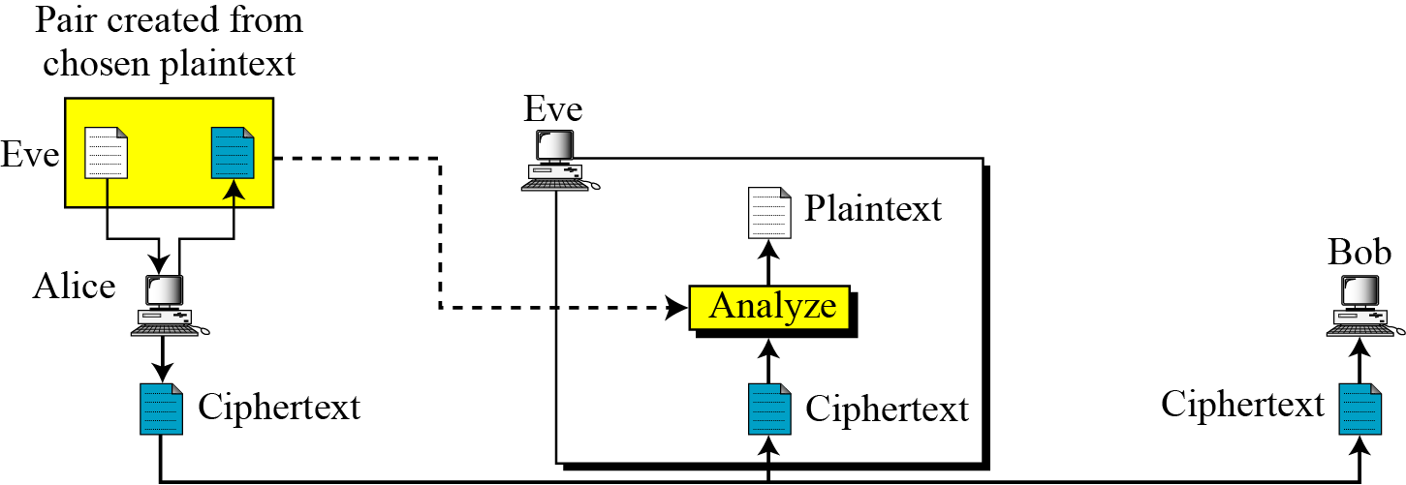
Chosen-Plaintext Attack

Slide 25
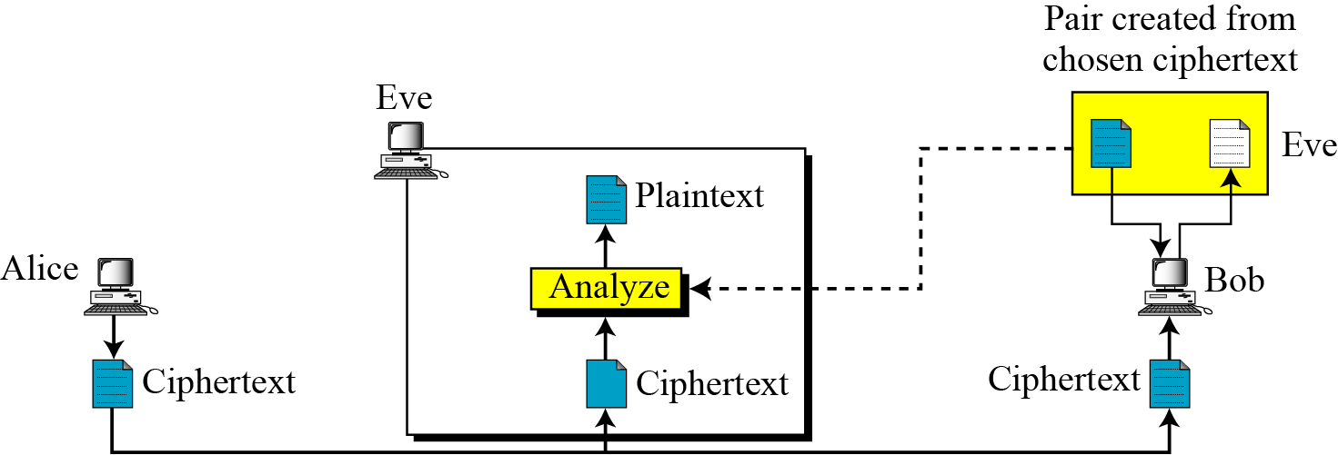
Chosen-Ciphertext Attack
Chosen-ciphertext attack

Slide 26
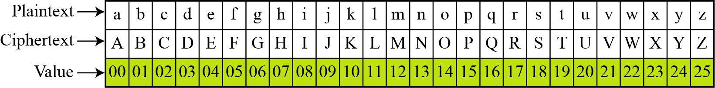
MONOALPHABETIC CIPHER: Additive Cipher
The simplest monoalphabetic cipher is the additive cipher. This cipher is sometimes called a shift cipher and sometimes a Caesar cipher, but the term additive cipher better reveals its mathematical nature.
Plaintext and ciphertext in Z₂₆

Slide 27
Caesar Cipher
Mathematically, map letters to numbers:
  a, b, c, ..., x, y, z
  0, 1, 2, ..., 23, 24, 25
Then the general Caesar cipher is:
  c = E_{K}(p) = (p + k) mod 26
  p = D_{K}(c) = (c – k) mod 26
Can be generalized with any alphabet.

Slide 28
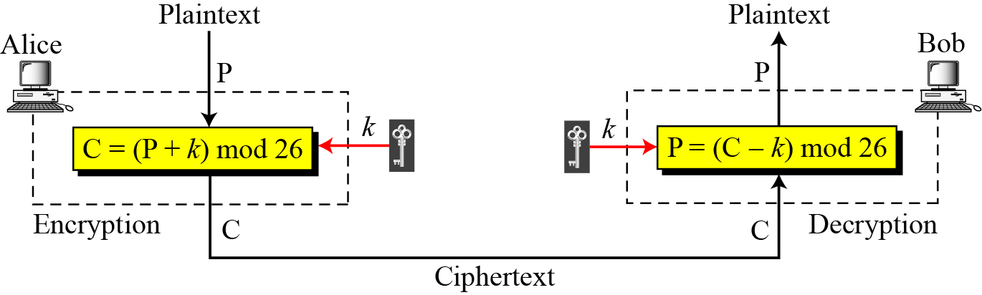

Additive cipher
Note
When the cipher is additive, the plaintext, ciphertext, and key are integers in Z₂₆.

Slide 29
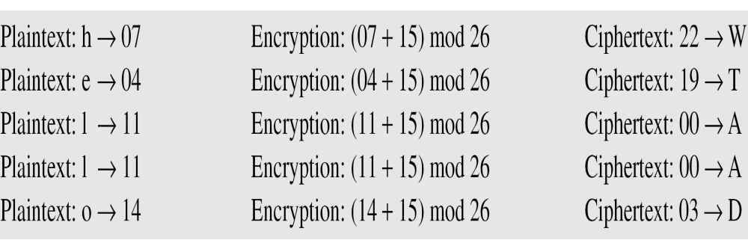
Example
Use the additive cipher with key = 15 to encrypt the message “hello”.
Solution
We apply the encryption algorithm to the plaintext, character by character:

Slide 30
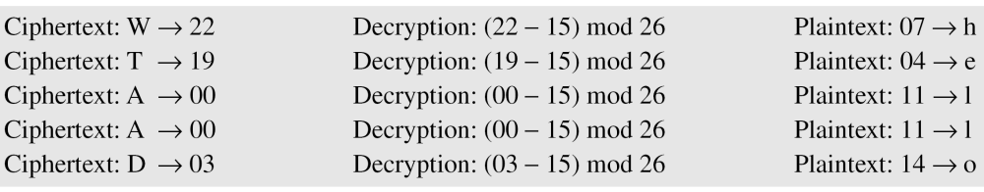
Use the additive cipher with key = 15 to decrypt the message “WTAAD”.
Solution
We apply the decryption algorithm to the plaintext character by character:

Slide 31
Shift Cipher and Caesar Cipher
Historically, additive ciphers are called shift ciphers. Julius Caesar used an additive cipher to communicate with his officers. For this reason, additive ciphers are sometimes referred to as the Caesar cipher. Caesar used a key of 3 for his communications.
Note
Additive ciphers are sometimes referred to as shift ciphers or Caesar cipher.

Slide 32
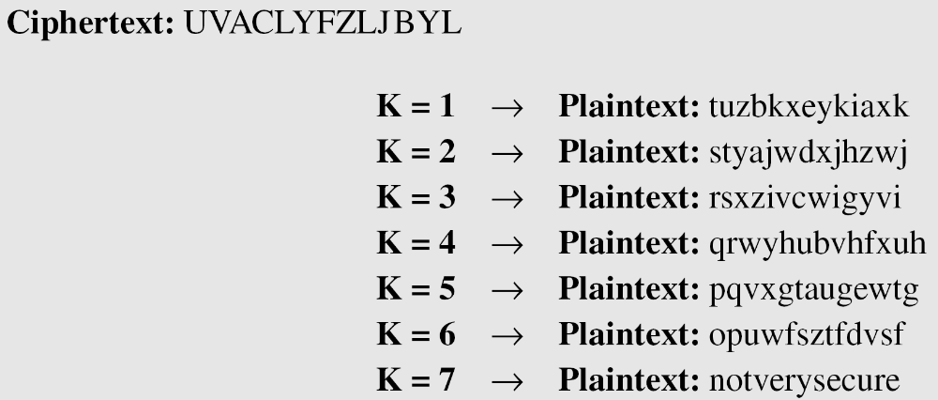
EXAMPLE
Eve has intercepted the ciphertext “UVACLYFZLJBYL”. Show how she can use a brute-force attack to break the cipher.
Solution
Eve tries keys from 1 to 7. With a key of 7, the plaintext is “not very secure”, which makes sense.
3.<number>

Slide 33
Monoalphabetic Substitution Cipher
Shuffle the letters and map each plaintext letter to a different random ciphertext letter:
  Plain letters: abcdefghijklmnopqrstuvwxyz
  Cipher letters: DKVQFIBJWPESCXHTMYAUOLRGZN
  Plaintext: ifwewishtoreplaceletters
  Ciphertext: WIRFRWAJUHYFTSDVFSFUUFYA
What does a key look like?

Slide 34
Monoalphabetic Cipher Security
Now we have a total of 26! = 4 x 10²⁶ keys.
With so many keys, it is secure against brute-force attacks.
But it is not secure against cryptanalytic attacks.
Because of invariant characteristics of the language in use.

Slide 35
Language Statistics and Cryptanalysis
Human languages are not random.
Letters are not equally frequently used.
In English, E is by far the most common letter, followed by T, R, N, I, O, A, S.
Other letters like Z, J, K, Q, X are fairly rare.
There are tables of single, double & triple letter frequencies for various languages

Slide 36
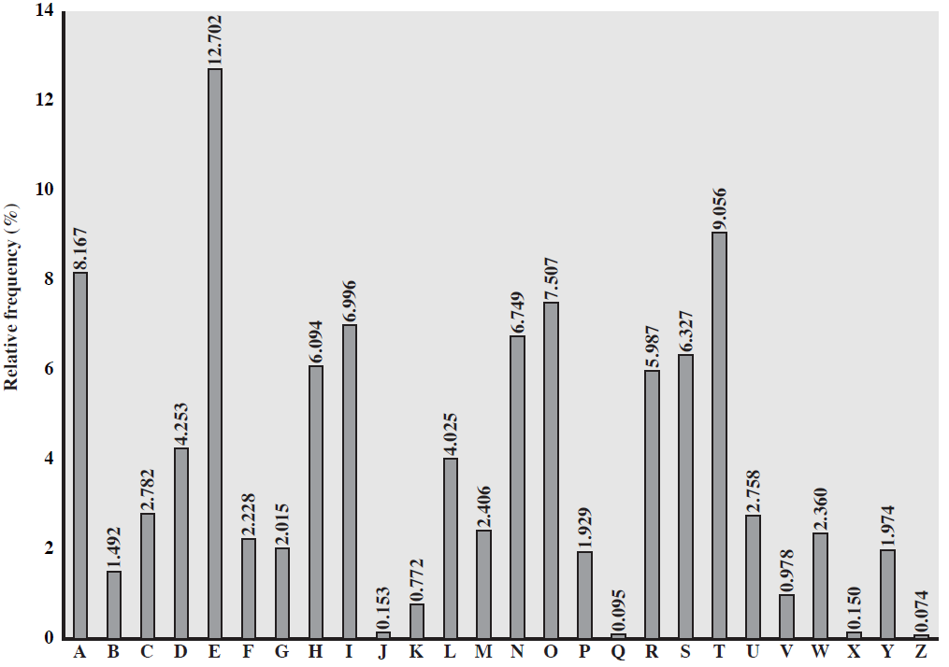
English Letter Frequencies

Slide 37
Statistics for double & triple letters
In decreasing order of frequency
Double letters:
th he an in er re es on, …
Triple letters:
the and ent ion tio for nde, …

Slide 38
Use in Cryptanalysis
Key concept: monoalphabetic substitution does not change relative letter frequencies
To attack, we
  calculate letter frequencies for ciphertext
  compare this distribution against the known one

Slide 39
Example Cryptanalysis
Given ciphertext:
  UZQSOVUOHXMOPVGPOZPEVSGZWSZOPFPESXUDBMETXAIZVUEPHZHMDZSHZOWSFPAPPDTSVPQUZWYMXUZUHSXEPYEPOPDZSZUFPOMBZWPFUPZHMDJUDTMOHMQ
  Frequency Counts:
P 13.33 | H 5.83 | F 3.33 | B 1.67 | C 0.00
Z 11.67 | D 5.00 | W 3.33 | G 1.67 | K 0.00
S 8.33 | E 5.00 | Q 2.50 | Y 1.67 | L 0.00
U 8.33 | V 4.17 | T 2.50 | I 0.83 | N 0.00
O 7.50 | X 4.17 | A 1.67 | J 0.83 | R 0.00
M 6.67

Slide 40
Relative letter frequencies Guess {P, Z} = {e, t}
Of double letters, ZW has highest frequency, so guess ZW = th and hence ZWP = the
Proceeding with trial and error finally get:
  The Message is:
  it was disclosed yesterday that several informal but direct contacts have been made with political representatives of the viet cong in moscow

Slide 41
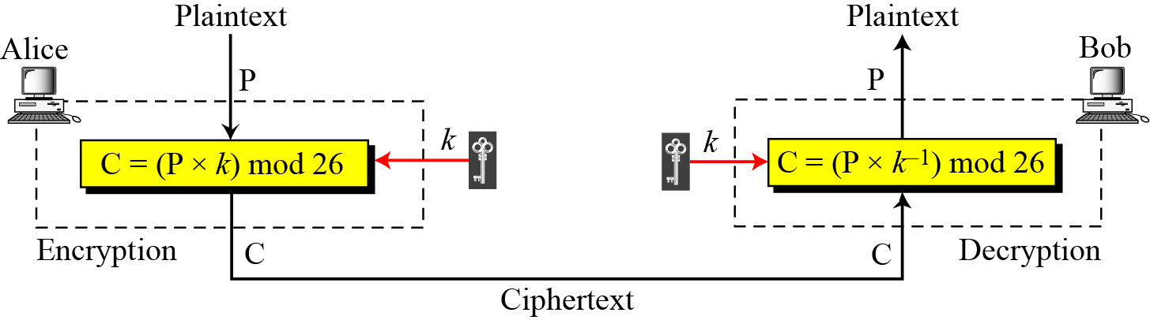
Multiplicative Ciphers
Multiplicative cipher
Note
In a multiplicative cipher, the plaintext and ciphertext are integers in Z₂₆; the key is an integer in Z26*.
3.<number>

Slide 42
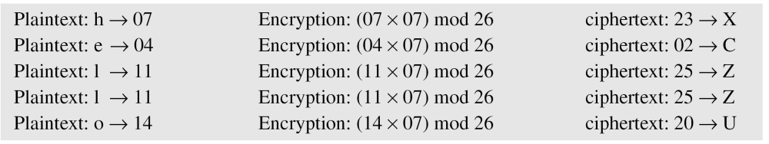
What is the key domain for any multiplicative cipher?
Solution
The key needs to be in Z₂₆*. This set has only 12 members: 1, 3, 5, 7, 9, 11, 15, 17, 19, 21, 23, 25.
Example
We use a multiplicative cipher to encrypt the message “hello” with a key of 7. The ciphertext is “XCZZU”.
3.<number>

Slide 43
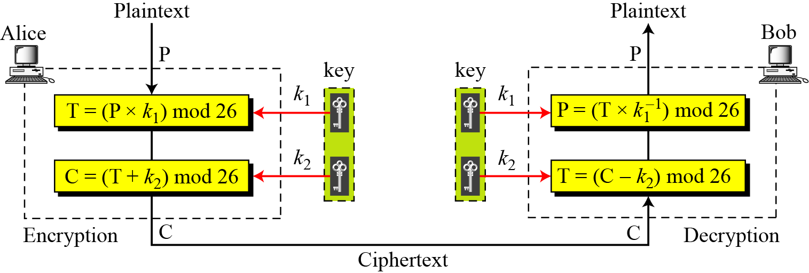
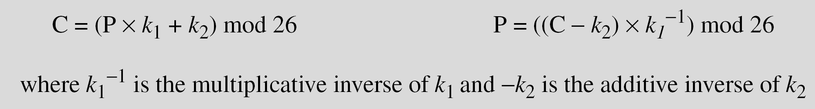
Affine Ciphers
3.<number>

Slide 44
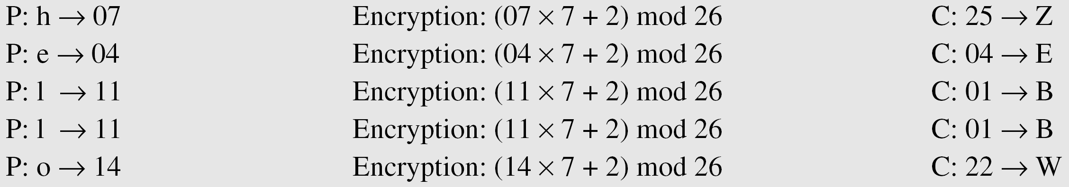
The affine cipher uses a pair of keys in which the first key is from Z₂₆* and the second is from Z₂₆. The size of the key domain is 26 × 12 = 312.
Example
Use an affine cipher to encrypt the message “hello” with the key pair (7, 2).

Slide 45
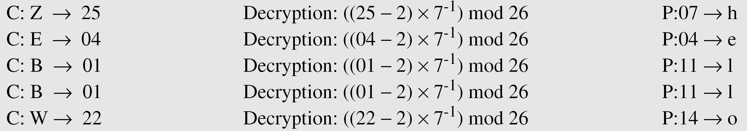
Example
Use the affine cipher to decrypt the message “ZEBBW” with the key pair (7, 2) in modulus 26.
Solution
NOTE
The additive cipher is a special case of an affine cipher in which
k₁ = 1. The multiplicative cipher is a special case of affine cipher in which k₂ = 0.
3.<number>

Slide 46
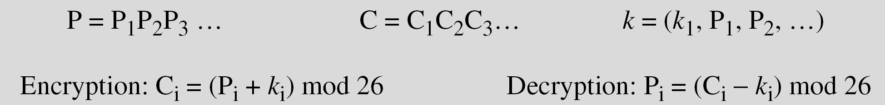
Polyalphabetic Ciphers
In polyalphabetic substitution, each occurrence of a plain character may have a different substitute. The relationship between a character in the plaintext to a character in the ciphertext is one-to-many.
Example: Autokey Cipher

Slide 47
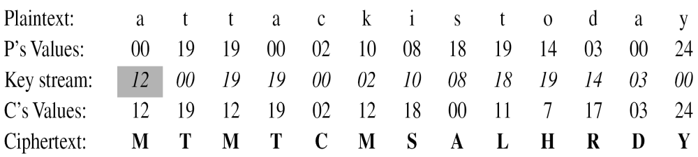
Example
Assume that Alice and Bob agreed to use an autokey cipher with initial key value k1 = 12. Now Alice wants to send Bob the message “Attack is today”. Enciphering is done character by character.

Slide 48
STREAM AND BLOCK CIPHERS
The symmetric ciphers are categorised into two broad categories:
Stream ciphers: The Encryption takes place bit by bit or character by character
Block Cipher: The fixed size block om message is encryted/decrypted at a time.
These definitions are normally applied to modern ciphers, this categorization also applies to traditional ciphers.
3.<number>

Slide 49
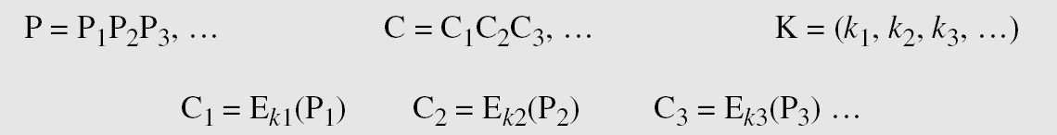
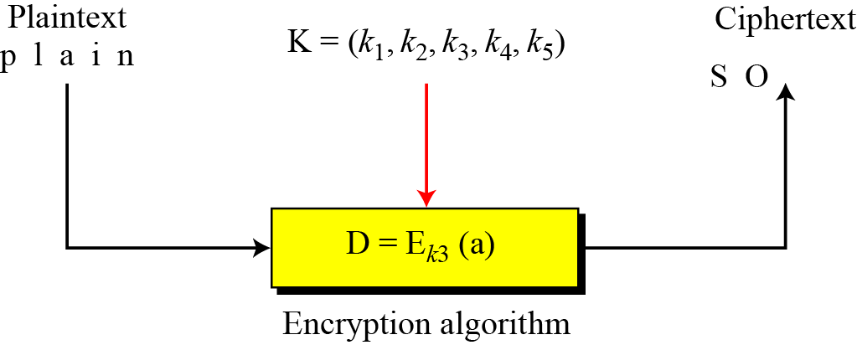
Stream Ciphers
Call the plaintext stream P, the ciphertext stream C, and the key stream K.
Stream cipher

Slide 50
Continued
Example
Additive ciphers can be categorized as stream ciphers in which the key stream is the repeated value of the key. In other words, the key stream is considered as a predetermined stream of keys or
K = (k, k, …, k). In this cipher, however, each character in the ciphertext depends only on the corresponding character in the plaintext, because the key stream is generated independently.
Example
The monoalphabetic substitution ciphers discussed in this chapter are also stream ciphers. However, each value of the key stream in this case is the mapping of the current plaintext character to the corresponding ciphertext character in the mapping table.
3.<number>

Slide 51
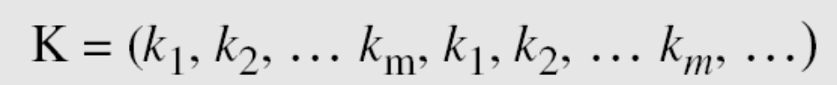
Continued
Example
Vigenere ciphers are also stream ciphers according to the definition. In this case, the key stream is a repetition of m values, where m is the size of the keyword. In other words,
Example
We can establish a criterion to divide stream ciphers based on their key streams. We can say that a stream cipher is a monoalphabetic cipher if the value of k_{i} does not depend on the position of the plaintext character in the plaintext stream; otherwise, the cipher is polyalphabetic.
3.<number>

Slide 52
Continued
Example
(Continued)
Additive ciphers are definitely monoalphabetic because k_{i} in the key stream is fixed; it does not depend on the position of the character in the plaintext.
Monoalphabetic substitution ciphers are monoalphabetic because k_{i} does not depend on the position of the corresponding character in the plaintext stream; it depends only on the value of the plaintext character.
Vigenere ciphers are polyalphabetic ciphers because k_{i} definitely depends on the position of the plaintext character. However, the dependency is cyclic. The key is the same for two characters m positions apart.
3.<number>

Slide 53
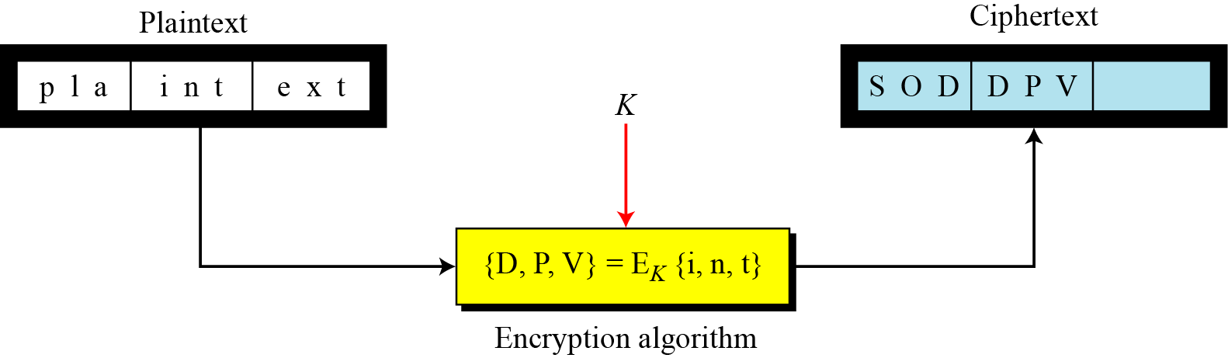
BlockCiphers
In a block cipher, a group of plaintext symbols of size m (m > 1) are encrypted together creating a group of ciphertext of the same size. A single key is used to encrypt the whole block even if the key is made of multiple values.
Block cipher
3.<number>

Slide 54
Continued
Example
Playfair ciphers are block ciphers. The size of the block is m = 2. Two characters are encrypted together.
Example
Hill ciphers are block ciphers. A block of plaintext, of size 2 or more is encrypted together using a single key (a matrix). In these ciphers, the value of each character in the ciphertext depends on
all the values of the characters in the plaintext. Although the key is made of m × m values, it is considered as a single key.
Example
From the definition of the block cipher, it is clear that every block cipher is a polyalphabetic cipher because each character in a ciphertext block depends on all characters in the plaintext block.
3.<number>

